Slide 1
PESTAL FRAMEWORK
There are many factors in the macro-environment that will effect the decisions of the managers of any organization.
To help analyze these factors managers can categorize them using the PESTEL model.

Slide 2
What is a PEST analysis?
A PEST analysis is a strategic business tool used by organizations to discover, evaluate, organize, and track macro-economic factors which can impact on their business now and in the future. The framework examines opportunities and threats due to Political, Economic, Social, and Technological forces. Outputs from the analysis inform strategic planning processes and contribute to market research

Slide 3
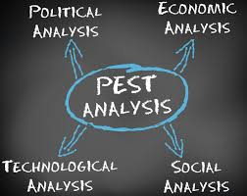

Slide 4
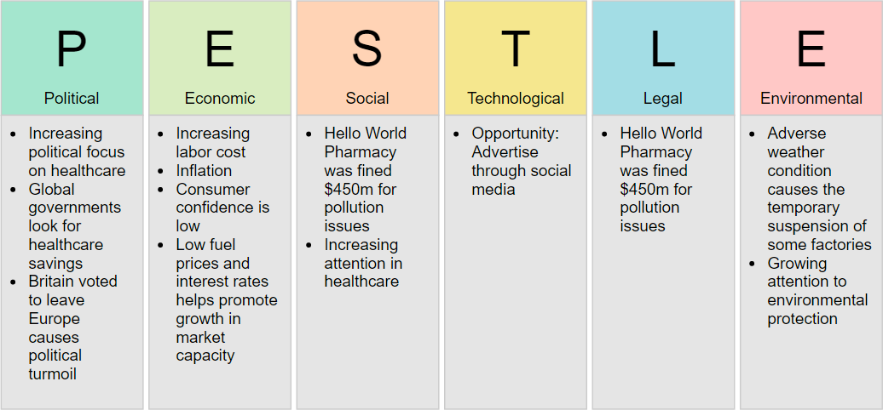

Slide 5
Political or politically motivated factors that could impact the organization.
Examples include:
Government policy, political stability or instability, bureaucracy, corruption, competition regulation, foreign trade policy, tax policy, trade restrictions, labor/environmental/copyright/consumer protection laws, funding grants & initiatives, etc.
Questions to ask:
What government policies or political groups could be beneficial or detrimental to our success?
Is the political environment stable or likely to change?

Slide 6
Here government regulations and legal factors are assessed in terms of their ability to affect the business environment and trade markets.
The main issues addressed in this section include
political stability,
tax guidelines,
trade regulations,
safety regulations, and
employment laws.

Slide 7
Economic
Overall economic forces that could impact on your success.
Examples include:
Economic trends, growth rates, industry growth, seasonal factors, international exchange rates, International trade, labor costs, consumer disposable income, unemployment rates, taxation, inflation, interest rates, availability of credit, monetary policies, raw material costs, etc.
Questions to ask:
What economic factors will affect us moving forward?
How does the performance of the economy affect us at the moment?
How are our pricing, revenues, and costs impacted by each economic factor?

Slide 8
Social
Social attitudes, behaviors, and trends that impact on your organization and target market.
Examples include:
Attitudes and shared beliefs about a range of factors including money, customer service, imports, religion, cultural taboos, health, work, leisure, the environment; population growth and demographics, immigration/emigration, family size/structure, lifestyle trends, etc.
Questions to ask
How do our customer’s beliefs and values influence their buying habits?
How do cultural trends and human behavior play a role in our business?

Slide 9
Technological
Technology that can affect the way you make, distribute, and market your products and services.
Examples include:
Technology and communications infrastructure, legislation around technology, consumer access to technology, competitor technology and development, emerging technologies, automation, research and innovation, intellectual property regulation, technology incentives, etc.
Questions to ask:
What technological advancements and innovations are available or on the horizon?
How will this technology impact on our operations?

Slide 10
Environmental factors
Environmental factors include the weather and climate change
Changes in temperature can impact on many industries including farming, tourism and insurance
With major climate changes occurring due to global warming and with greater environmental awareness this external factor is becoming a significant issue for firms to consider

Slide 11
1.Changes in weather and climate Laws
2.Regarding pollution and recycling
3.Waste management
Use of green or eco-friendly products and practices

Slide 12
Legal factors
These are related to the legal environment
in which firms operate.
Discrimination laws
Health and safety laws
Consumer protection laws
Copyright and patent laws
Interest on saving bank a/c

Slide 13
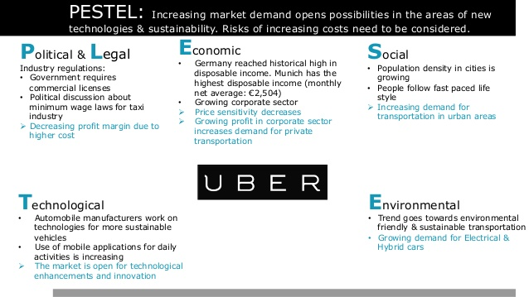

Slide 14
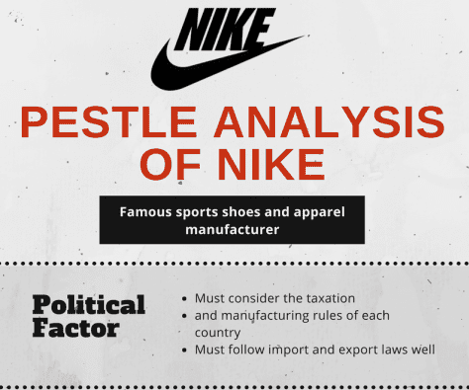

Slide 15
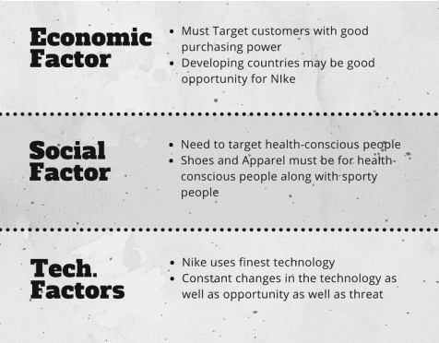

Slide 16
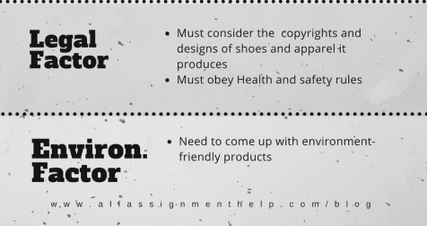

Slide 17
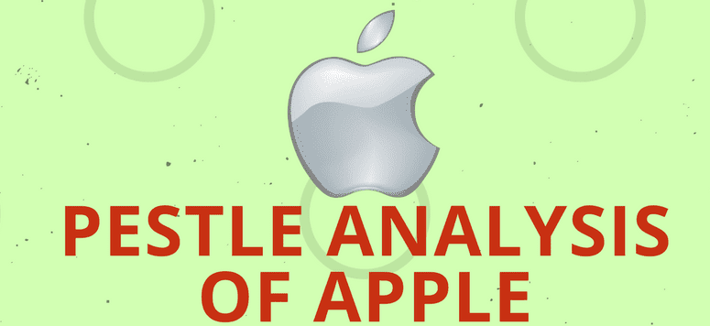

Slide 18
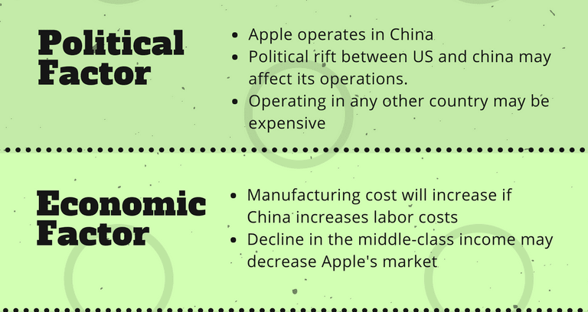

Slide 19
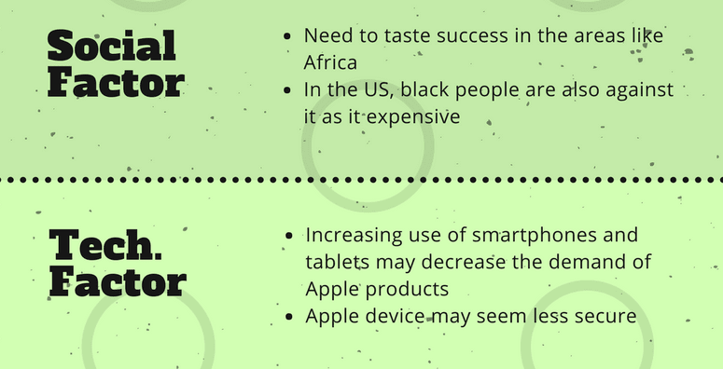

Slide 20
